Slide 1
Dynamic programming reference: CLRS Student: Mahdi Rostami
Doctor Farahani
Shahid Beheshti university
1400

Slide 2
Recursive algorithms:
There are 2 types of subproblems:
Subproblems are not independent (when subproblems overlap)
Subproblems are independent

Slide 3
Optimization problems:
Basis:
1. Characterize the structure of an optimal solution.
2. Recursively define the value of an optimal solution.
3. Compute the value of an optimal solution in a bottom-up fashion.
Value of an optimal solution:
4. Construct an optimal solution from computed information.

Slide 4

i = 1, 2, 3, … ,n (inch) pi = price of the rod (length i)
Rod cutting
Note that if the price p(n) for a rod of length n is large enough, an optimal solution may require no cutting at all.
We can cut up a rod of length n in 2^(n-1) different ways, since we have an independent option of cutting, or not cutting, at distance i inches from the left end.

Slide 5
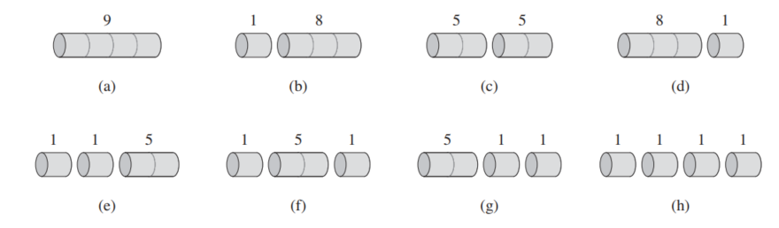
Rod cutting(a sample)

Slide 6

optimal substructure: optimal solutions to a problem incorporate optimal solutions to related subproblems, which we may solve independently.

Slide 7
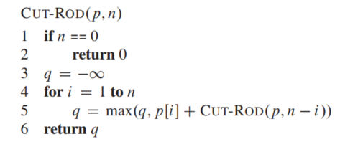
A recursive solution
top-down, recursive manner.

Slide 8
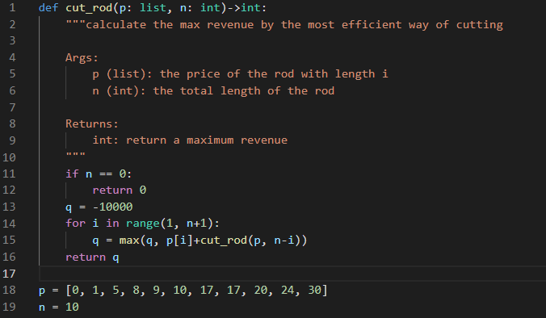
A recursive solution

Slide 9
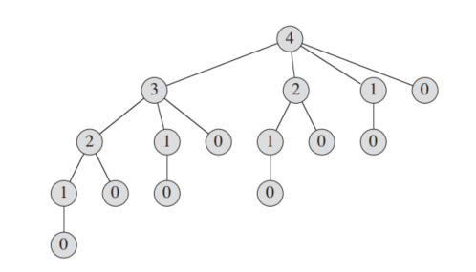
A recursive solution
Why is CUT-ROD so inefficient?
recursion tree T(0) = 1
T(n) = 2^(n-1)

Slide 10
Using dynamic programming for optimal rod cutting
There are usually two equivalent ways to implement a dynamic programming approach.
top-down with memoization
bottom-up method

Slide 11
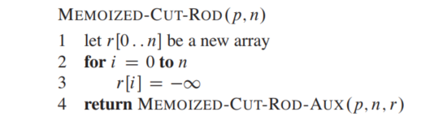
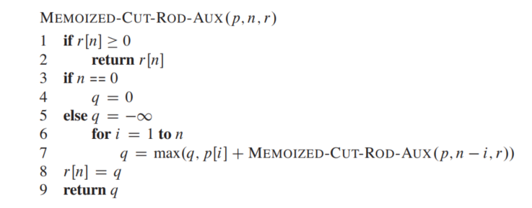
top-down with memoization
auxiliary array r[0..n]
T(n) = n^2

Slide 12
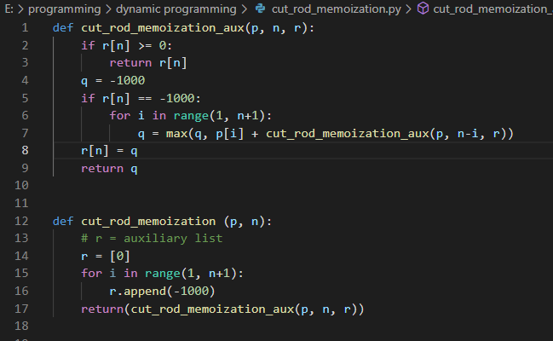
top-down with memoization

Slide 13
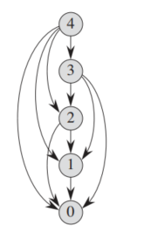
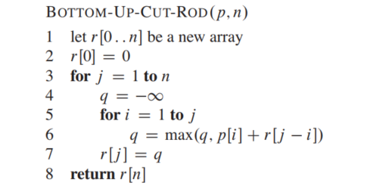
Bottom-up version
T(n) = n^2

Slide 14
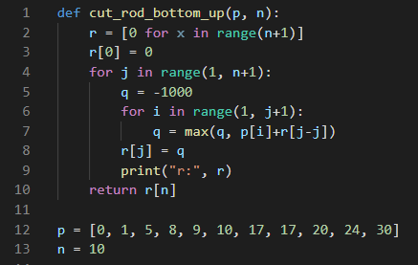
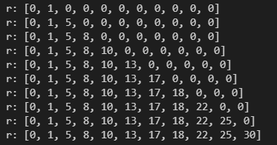
Bottom-up version

Slide 15
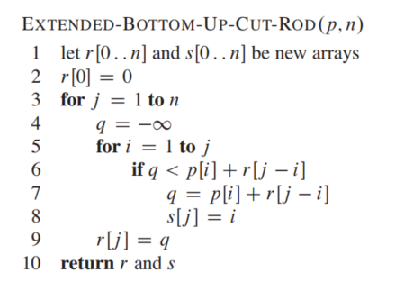
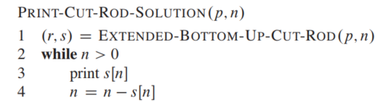

Reconstructing a solution

Slide 16
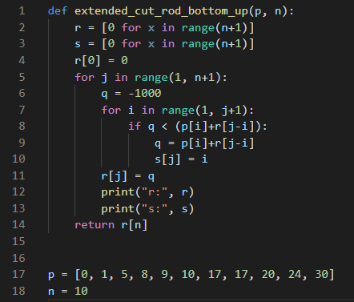
Reconstructing a solution

Slide 17
You can see all of the codes on: https://github.com/rostamimahdi1997/dynamic

